Slide 1


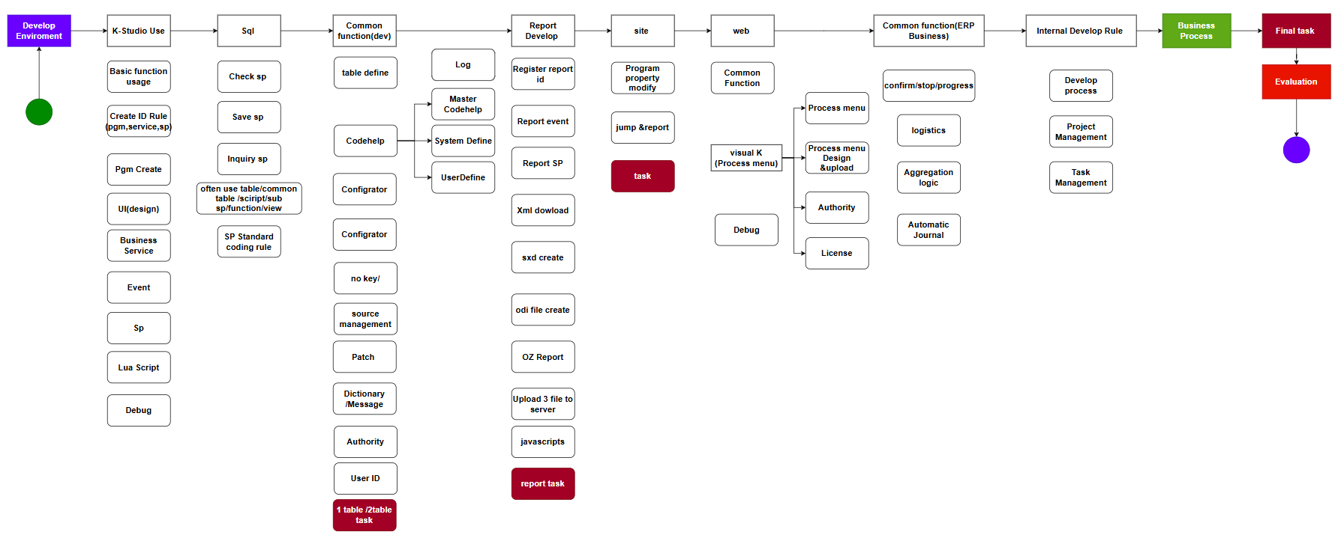
Important !!!: Check the development rule from manual download Program.
Curriculum
MNG
Curriculum
List
Training
Manual

